Slide 1
Adapting UI to different screens Developer’s Guide to Windows 10

Slide 2
Agenda
The Microsoft design language
How Windows makes design easier
What am I designing?
Adaptive UI Techniques
Adaptive UI Tooling
Visual States Triggers
Relative Panel

Slide 3
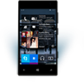
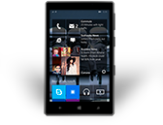
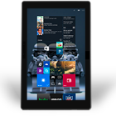
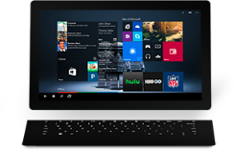
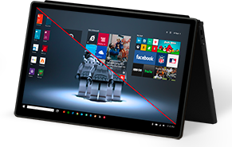
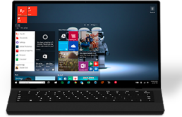
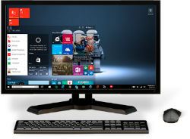
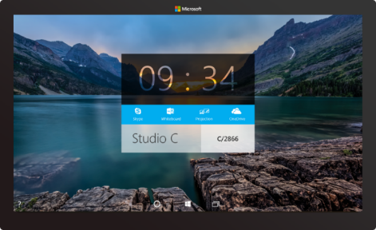

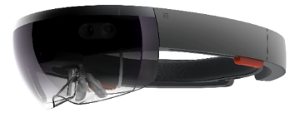
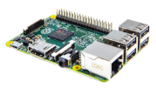

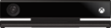
2-in-1s (Tablet or Laptop)
Classic Laptop
Desktops & All-in-Ones
Phone
Phablet
Small Tablet
Large Tablet
Windows 10
Surface Hub
Xbox
Holographic
IoT
Notes:
The Windows 10 family comprises many different device types with screens ranging from the very tiny on IoT devices, through phones, phablets, tablets, laptops, convertibles, desktops, Xbox and Surface Hub, including innovative displays such as the HoloLens.
This session is about how to create an adaptive UI that will allow one app to run on a broad range of these devices but which also adapts its UI to give a great experience, no matter which screen it is running on.

Slide 4
UWP Design principles and adaptive UI features
Notes:
First, let’s look at some design principles and at some platform features

Slide 5
We want you to use your design, fonts, icons etc… If you’re stuck, or need inspiration, we share our first party guidance that you can use
Notes:
Firstly, you may notice that the Visual Studio 2015 New Project templates do not include examples of different styles of apps, unlike previous versions. In fact, for interactive apps, there’s only one new project template: the Blank App.
Microsoft is trying to be less prescriptive about design layouts than we have in the past. We want you to use your own designs, fonts and icons and with UWP you can do that.
If you want to seek inspiration and guidance on how to create an effective layout, you can take a look at the built-in apps that we ship with Windows 10.

Slide 6
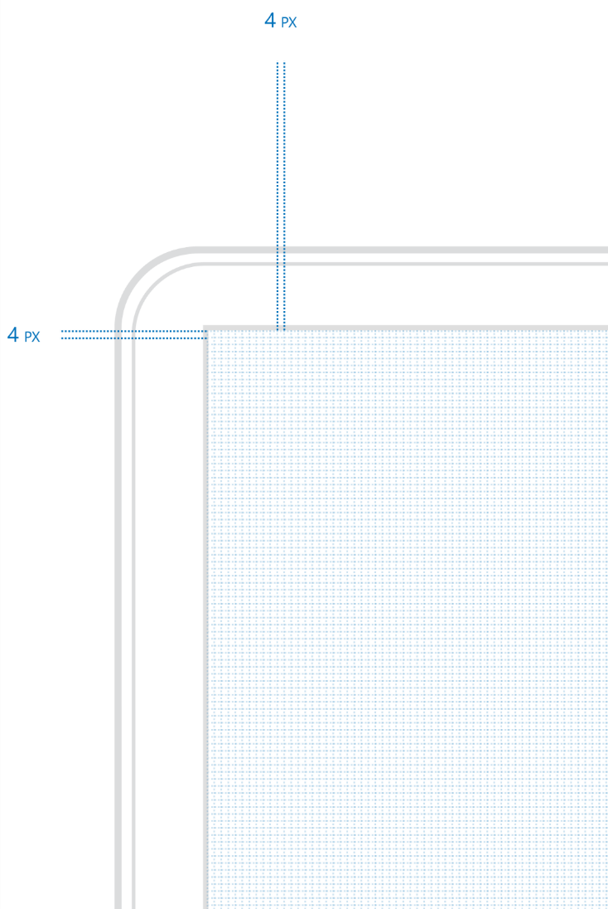
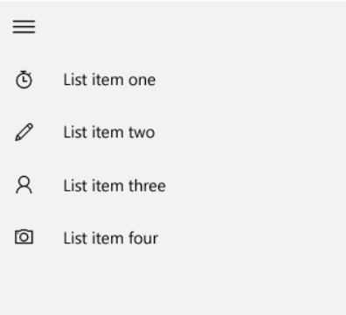
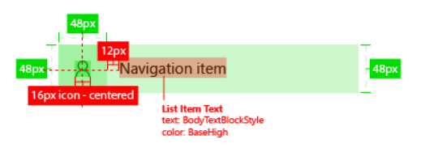
Four is the magic number
Notes:
First important rule of UWP design is that your sizes, margins, spacing should all be cleanly divisible by four.
The reason for this is that we have adopted a common effective pixel size across all our devices. You create layouts using effective pixels, which is independent of physical screen resolution. However, as your app runs on many different screens at many different physical screen resolutions, the display system scales your UI up or down as necessary.
By making all your sizes cleanly divisible by four, you will end up with crisper layout and text and avoid fuzziness.

Slide 7
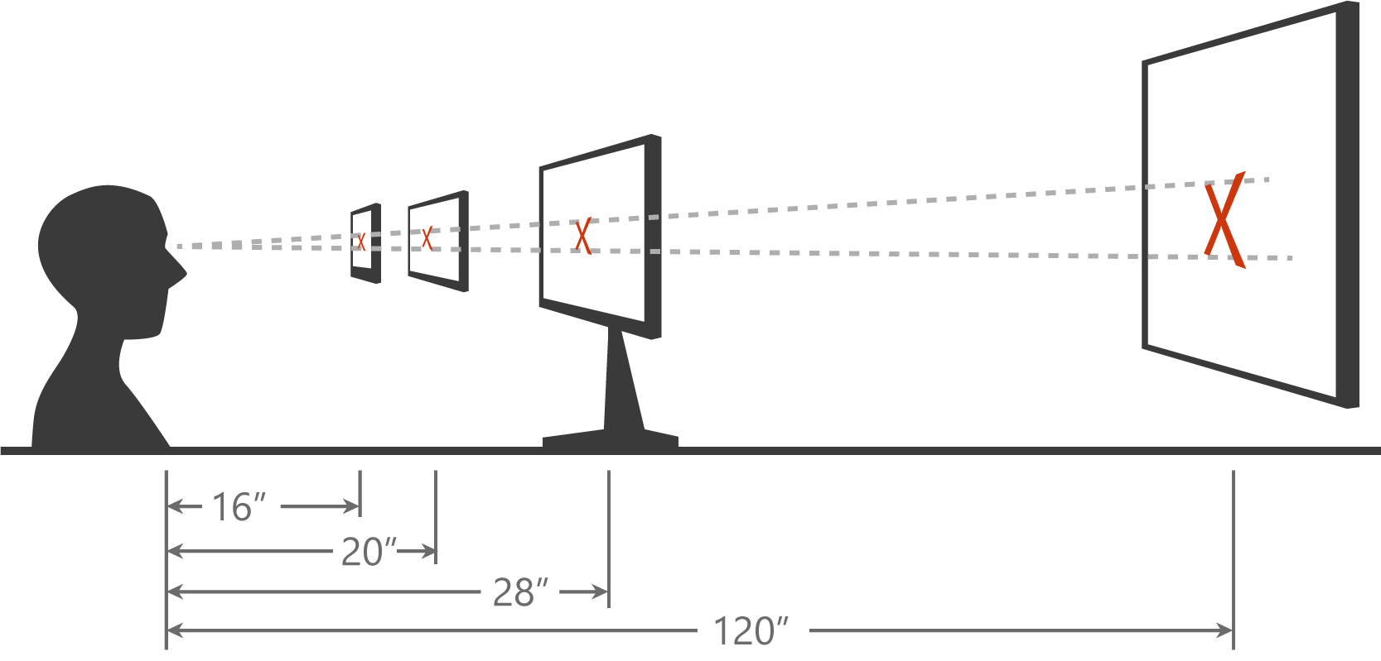
Scaling algorithm
Notes:
The effective pixel system takes into account a number of factors and allows you to layout your pages without having to adjust for the device type or the physical screen resolution.
One factor that determines how large the system will render an item on a particular screen is the scaling algorithm. This takes into account the typical viewing distance of a class of device – a phone is typically held close to the eyes, whereas tablets are held further back, PCs/laptops further back again, and Surface Hub is typically viewed across a room. The scaling algorithm ensures that when you size some UI feature using effective pixels, it will have the same perceivable size regardless if which device it is displayed upon.

Slide 8
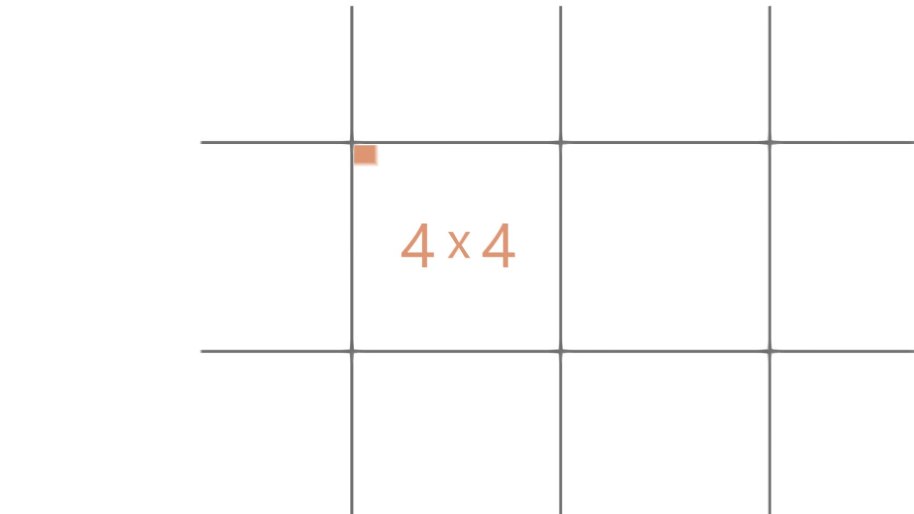
Notes:
Video – This has audio track.
Alternatively, turn off sound and make your own spoken commentary over the video.

Slide 9
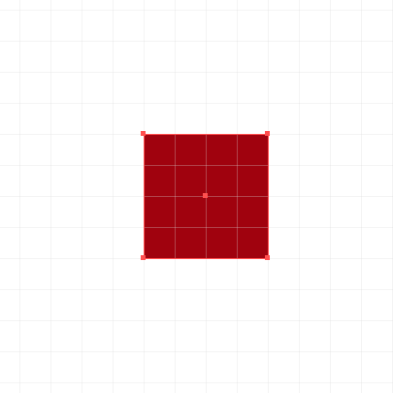
Effective pixel
Physical Pixel
Effective Pixel
Notes:
As you can see, an effective pixel is a logical sizing unit that actually consists of one or more physical pixels.

Slide 10
Ignore scale, resolution, & dpi. Design in Effective Pixels XAML is already in Effective Pixels
Notes:
In UWP XAML, all sizes are in effective pixels. You can ignore viewing distance, screen resolution – just design in effective pixels, confident that your designs will look appropriate whichever screen they display on.

Slide 11
What am I designing?
Notes:
Now let’s consider some guidelines on how to approach the task of creating an adaptive UI that scales well across multiple screen sizes and orientations.

Slide 12
Planning your design
5”
8”
13”
Phone
Viewing Distance: 16.3”
Tablets and 2 in 1
Viewing Distance:
20”
Small and Large Laptops
Viewing Distance:
24.5”
Small and Large Desktop Monitors
Viewing Distance:
28”
TV
Viewing Distance:
84”
Notes:
When you think of the broad range of screen sizes available across all Windows 10 devices, from 4.5” phones up to the 84” Surface Hub, it can seem daunting to create an adaptive UI that will work well across all of these.
Our advice is to target a few key scenarios:
5” phone in portrait
8” tablet in portrait and landscape
13” laptop/PC in landscape
If you focus on these key targets, and use adaptive layout techniques such as Grid layout and controls that can wrap and flow output such as the TextBlock with Wrapping set to true, then you should find that you will end up with good results across all the targeted devices and also on those intermediaries.
You can then target additional screens such as large monitors, Surface Hub or Xbox if it makes sense for your app.

Slide 13
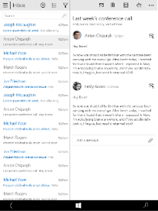
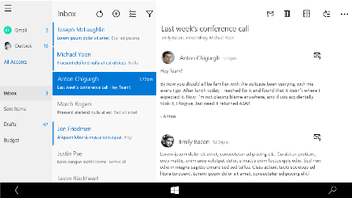
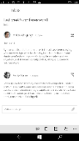
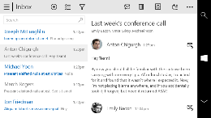
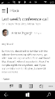
Snap points
epx
320
548
720
1024
phone
phablet & tablet
desktop
Notes:
As you think about what to show on different screens, you will often decide to show more content on larger displays where screen size is not as constrained as on a small screen such as a phone.
A great example is the Mail app. On a desktop display, this adopts a three column layout, with a navigation pane on the left, listing to its right and then perhaps something like a preview pane on the right side of the screen.
As we move down to a phablet or tablet, the layout shrinks to a two-column design. Here, the navigation panel is no longer on the primary layout but has been hidden away and is accessible by a ‘hamburger’ button. The mail listing and the preview pane remains though.
Move down again to a phone display and now the Mail app shrinks again to a one-column layout. The primary screen shows the mail listing, but then to read a mail message, the user taps on an entry in the list and a new page opens to allow reading of the full message.

Slide 14
Demo: Calculator
Notes:
Open the built-in Calculator app on a desktop.
Switch to the scientific layout as this has a richer UI.
Slowly resize the window, showing how parts of the UI are removed as the window size reduces, and that margins and spacing reduces as the screen gets smaller.
Point out that on desktop at the narrowest window, effectively what you are looking at is the Phone display layout.

Slide 15
As you design
Adapt to size change
Adapt to input change
Rely on the scaling algorithm
Notes:
Bear these three things in mind as you design the UI for your app:
React to window size change and modify the positioning of blocks of content, perhaps show and hide features
Think also of how the user is interacting with your app. Many of the built-in controls automatically adapt to touch vs mouse/keyboard input but you may also be able to refine your layouts based on input method
Trust the effective pixels system! Design in Visual Studio so that it ‘looks right’ and you can be confident it will ‘look right’ across a broad range of Windows 10 displays. You will still refine the content displayed on the page based on screen sizes, but you don’t have to adjust sizing on account of screen width.

Slide 16
Design Techniques for Adaptive UI
Notes:
So far, we have identified the need to adjust the content that the user sees on a page according to the size of the display screen. But what techniques should you use for helping to decide what to show and what to hide?

Slide 17
Use standard responsive/adaptive design techniques
1
4
Reposition
Reveal
2
5
Resize
Replace
Reflow
3
6
Re-architect
Notes:
It should be no surprise that the techniques you should use for XAML pages are exactly the same as those used by web designers to create adaptive web pages. What we have done with Windows 10 is bring adaptive web UI techniques to native XAML apps.
Reposition – You can move blocks of content around on the page. For example, in landscape, you can have islands of content extending across the page horizontally, but in a narrow screen layout, move content so that it is laid out more like a single column.
Resize – You can simply allow content on the page to grow and shrink as the window size changes. Using a Grid with proportional column/row sizes is a great way of achieving this.
Reflow – This means to have text, for example, change from a single column on a narrow screen to span two or more columns on wider screens.
Reveal – here you will show additional content areas as the screen width increases, hide them as the screen width decreases.
Replace – With this technique you replace one layout of some content with a different layout depending on the screen size, to ensure a great, screen-appropriate layout on all screen sizes
Re-architect – When you re-architect, you go for a substantially different layout on different size screens, or on different device families. In XAML terms, this often means to navigate to a specific page for some scenario, such as when running on an Xbox, where the user interactions through a controller may be substantially different to the same app running on a PC or phone.

Slide 18
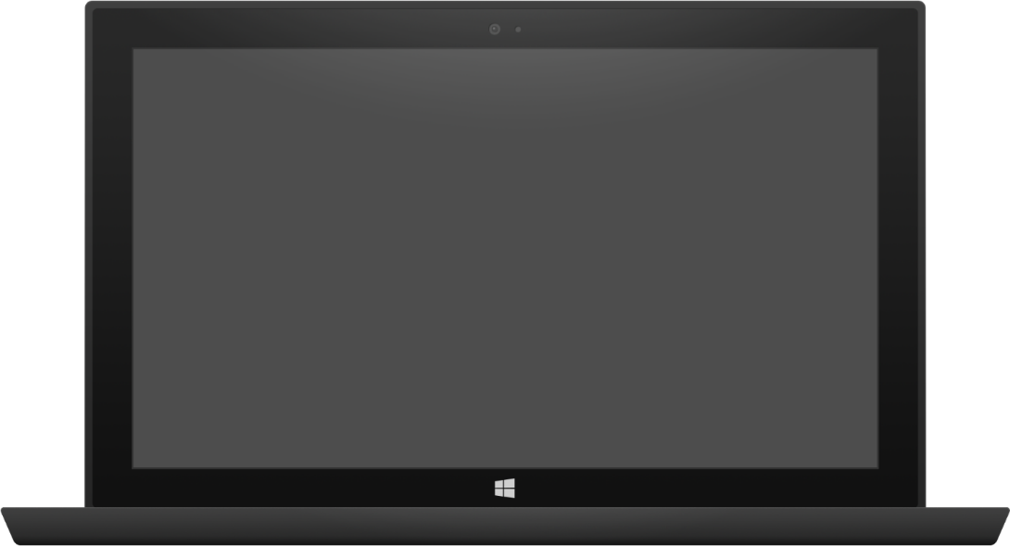
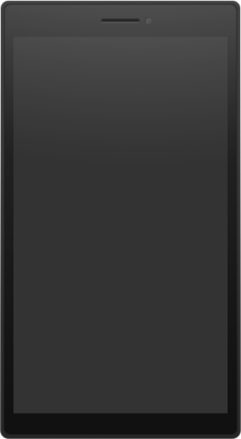
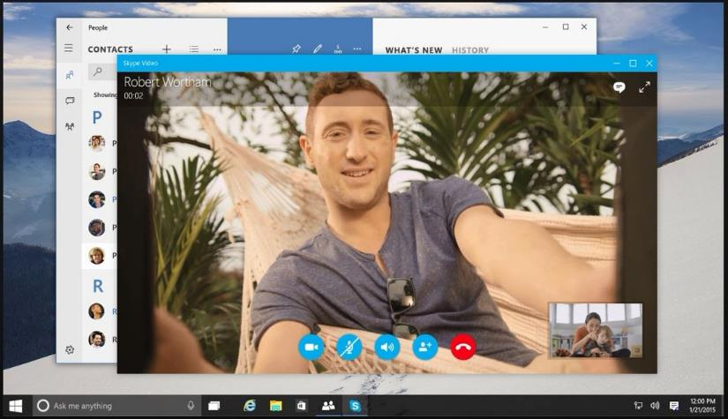

Adaptive design
Build a page that adapts to different screen sizes and orientations
Use Visual States and Adaptive Triggers to change layout
Use RelativePanel to position blocks of content relative to peers, re-positioning in different visual states
Tablet (landscape) / Desktop
Phone (portrait)
Notes:
In many cases, you will use the same display but adapt it using Visual States and – a new feature in UWP XAML - Adaptive Triggers to move content around, or to show/hide bits of content. Another new control, RelativePanel, is great for repositioning content under the control of Visual States – for example, repositioning the ‘End Call’ button underneath the other control buttons on the phone display shown here.

Slide 19
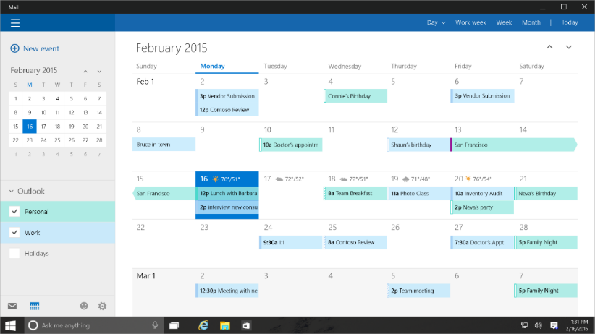
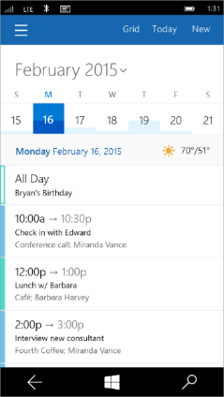
Tailored design
Build unique experiences on different devices
Tablet (landscape) / Desktop
Phone (portrait)
Notes:
Also as you design, think of the way the user interacts with yor app on a particular device. A great example is the calendar app. On a large screen, you will take advantage of the large display area to show a full month date picker, maybe some group selectors, and a rich display such as a full month view.
On a phone however, the user generally glances at their phone to find out what the next few appointments are that day. The primary usage scenario changes. All the information that is conveyed by the large screen display is still available on the phone, but only by navigating through some additional levels of menu and pages.

Slide 20
How to build an Adaptive UI
Notes:
That’s enough theory! How do we actually build an adaptive UI using UWP XAML?

Slide 21
Visual States
Define XAML views
Unique layout for distinct states
Simplify animation
Automatically implement state transitions
Build in Blend
Design and preview states and transitions
Notes:
With visual states and adaptive triggers, you target a universal experience by doing more purposeful sizing and positioning of UI elements to make the app adapt.
In these scenarios controls may be moved around and hidden using the VisualStateManager which can trigger on different window sizes. This means that your universal app projects no longer require separate project heads or UI definitions for small and large windows.
Blend is a great tool for working with Visual States as you can preview how a state looks in the visual designer. You cannot do this in Visual Studio.

Slide 22
Visual states allow you to define different selectable layouts that can be applied to your UI
Notes:
When you define a visual sate, you give it a name, and you change properties of the controls on your UI, such as visibility or sizes. These changes can be applied together when a particular named visual state is applied.

Slide 23
How to set the visual state in code
VisualStateManager.Goto(element, state, transition)
public MainPage()
{
this.InitializeComponent();
this.SizeChanged += (s, e) =>
{
var state = "VisualState000min";
if (e.NewSize.Width > 500)
state = "VisualState500min";
else if (e.NewSize.Width > 800)
state = "VisualState800min";
else if (e.NewSize.Width > 1000)
state = "VisualState1000min";
VisualStateManager.GoToState(this, state, true);
};
}
Notes:
Visual States are nothing new – they have always been in XAML.
Before UWP, they could only be activated in code. You can still use this technique today – however, there is a new, simpler method in UWP.

Slide 24
Adaptive triggers
Code-free state transition
Two built-in triggers
MinWindowHeight (Taller than this)
MinWindowWidth (Wider than this)
<VisualState x:Name="VisualState500min">
<VisualState.StateTriggers>
<AdaptiveTrigger MinWindowWidth="501" />
</VisualState.StateTriggers>
</VisualState>
Notes:
You can now define the trigger that causes a visual state to be activated directly in XAML.
Adaptive visual states allow you to change the visual state in response to changes in the width of the window based on MinWindowWidth or MinWindowHeight.

Slide 25
Adaptive triggers are a zero-code solution
Notes:
Adaptive Triggers defined in XAML are just a declarative way of activating visual states.

Slide 26
Visual state setters
Setting a simple, scalar value
Great when you think of ENUM values like Visibility, Stretch, etc
Does not invoke a storyboard
Does not require ObjectAnimationUsingKeyFrames
<VisualState.Setters>
<Setter Target="MyText01.FontSize" Value="24" />
<Setter Target="MyImage.Stretch" Value="UniformToFill" />
<Setter Target="MyImage.Height" Value="150" />
</VisualState.Setters>
Notes:
The other innovation in UWP around Visual States is Setters.
Prior to UWP, all property changes to controls applied within a visual state had to be defined in a storyboard. While you can still do this, a much simpler syntax can now be used for those properties that just need to change from one value to another, and do not need a timeline or gradual transition that is possible by using a storyboard.

Slide 27
XAML's RelativePanel control
A child or two act as a anchor elements
They are relative to the panel
Other children are relative to the anchors
RelativePanel.Above = "ElementName"
RelativePanel.RightOf = "ElementName"
RelativePanel.Below = "ElementName"
RelativePanel.LeftOf = "ElementName"
RelativePanel simplifies adaptive UI
A simple Visual State setter can rearrange the UI
One element can move a family of related elements
Notes:
Another key tool in the arsenal of developers of adaptive XAML UI is the RelativePanel.
RelativePanel is a constraint based layout container that you can use to create UIs by expressing spatial relationships between elements. Using RelativePanel’s attached properties, you can position a UI element relative to another UI element (A is RelativePanel.Below B) as well as relative to the panel (A is RelativePanel.AlignTopWithPanel).
It is particularly valuable when applying visual states in response to window size changes. It makes it very easy to reposition content on the page as the window size increases or decreases.

Slide 28
Demo: Building an Adaptive UI

Slide 29
Custom triggers support your special scenarios
Notes:
So far, we have looked at the two built-in adaptive triggers, MonWindowWidth and MinWindowHeight.
You can create custom triggers to support UI changes in response to any environmental change.

Slide 30
Custom adaptive triggers
Build to handle special cases.
public class DeviceFamilyTrigger : StateTriggerBase
{
private string _deviceFamily;
public string DeviceFamily
{
get { return _deviceFamily; }
set
{
var qualifiers = Windows.ApplicationModel.Resources.Core
.ResourceContext.GetForCurrentView().QualifierValues;
if (qualifiers.ContainsKey("DeviceFamily"))
SetActive(qualifiers["DeviceFamily"] == (_deviceFamily = value));
else
SetActive(false);
}
}
}
Notes:
To create a custom trigger, simply create a class that inherits fro StateTriggerBase.
Inside that, write some logic that tests the value of some environmental factor. Then when the case being tested is true, call the SetActive method inherited from the base class.
In the example shown here, the class has a public property of type DeviceFamily that you set in the XAML when you carete an instance of this trigger class. Then the code inside the setter of the DeviceFamily property tests whether the actual device family the app is running on is the same as the property value defined in the XAML. If it is, then it calls SetActive so the trigger value is true, and the visual state that is using this trigger will be selected.

Slide 31
Demo: Custom adaptive triggers

Slide 32
Building Tailored Views
Build unique experiences on different devices
One option: Build separate pages for individual families
Can interrogate resource qualifiers (from MRT) to determine the family
Option 2: Use XAML views
var qualifiers = Windows.ApplicationModel.Resources.Core .ResourceContext.GetForCurrentView().QualifierValues; if (qualifiers["DeviceFamily"] == "DeviceFamily-Xbox")
// optimized for games console
rootFrame.Navigate(typeof(MainPage_Xbox), e.Arguments);
else
rootFrame.Navigate(typeof(MainPage), e.Arguments);
Notes:
Finally, a note on creating tailored views.
One option is to create completely separate pages and to navigate to the unique page as appropriate.
Another option is to use XAML views, which are a group of XAML pages that share a code-behind. You use Modern Resource Technology (MRT) to select which XAML view is used based on the device family where the app is running.

Slide 33
Demo: XAML views

Slide 34
Developers have many tools to build an adaptive UI
Notes:
In summary, designers and developers have a great many tools to help them build an adaptive UI, including Visual States and Adaptive Triggers, RelativePanel, controls that have built-in responsive UI capabilities such as input method adaptability.

Slide 35
Review
The Microsoft design language
How Windows makes design easier
What am I designing?
Adaptive UI Techniques
Adaptive UI Tooling
Visual States Triggers
Relative Panel

